Slide 1
14.8 Lagrange Multipliers
Sometimes we need to find the extreme values of a function whose domain is constrained to lie within some particular subset of the plane—a disk, for example, a closed triangular
region, or along a curve. In this section, we explore a powerful method for finding extreme values of constrained functions: the method of Lagrange multipliers.
Constrained Maxima and Minima
We first consider a problem where a constrained minimum can be found by eliminating a variable.

Slide 3
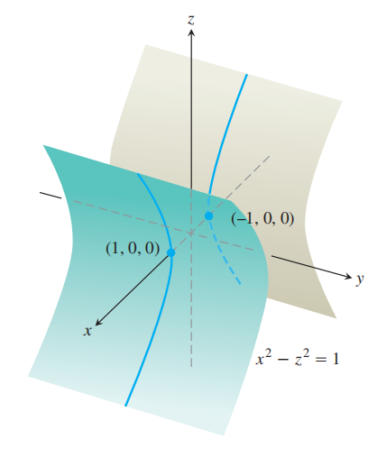
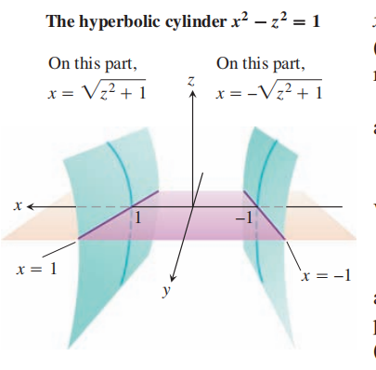

Slide 4
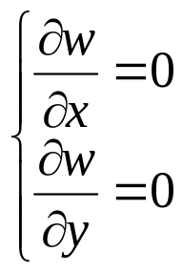
The Method of Lagrange Multipliers
To find the local maximum or minimum of
w=f(x, y, z)
subject to constraint g(x, y, z)=0, where f(x, y, z) and g(x, y, z) are differentiable.
Suppose that g(x, y, z)=0 defines a function z=φ(x, y)
implicitly, then
w=f(x, y, φ(x, y))
At the point where w attains its local maximum or local minimum,

Slide 5
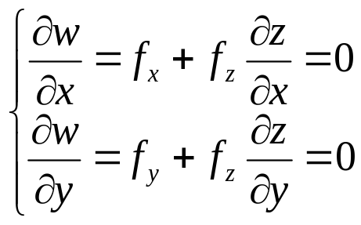
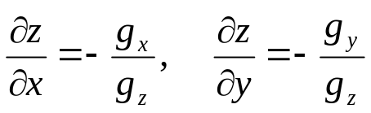
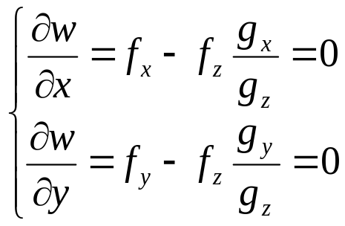
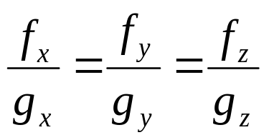
That is,
Since , then
Therefore,

Slide 6
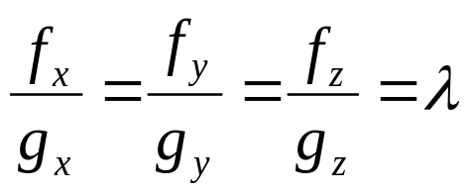
In summar, the point where w attains its local maximum or local minimum subject to the constraint g(x, y, z)=0 should satisfy
g(x, y, z)=0
For this reason, we can let
where λ is called Lagrange multiplier, and we construct an aid
function, called Lagrange function:

Slide 7
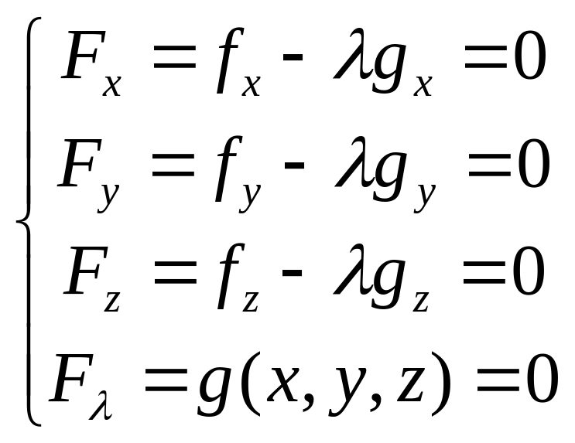
Then the suspicious local maximum or local minimum point(s) will satisfy

Slide 8
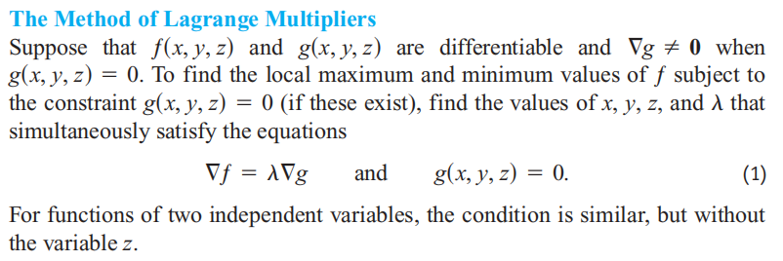

Slide 10
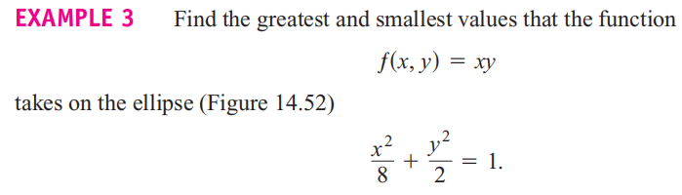

Slide 11
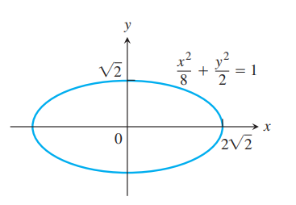
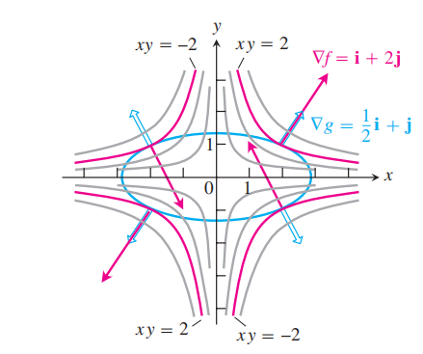
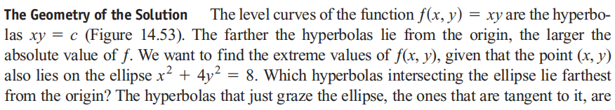
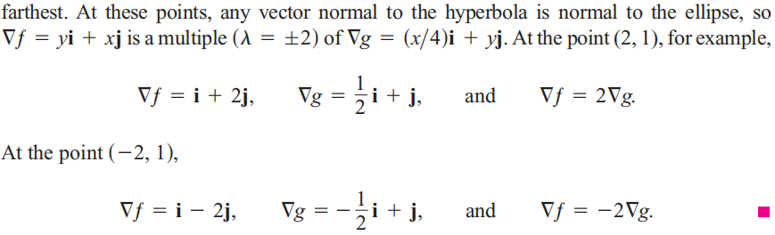

Slide 13
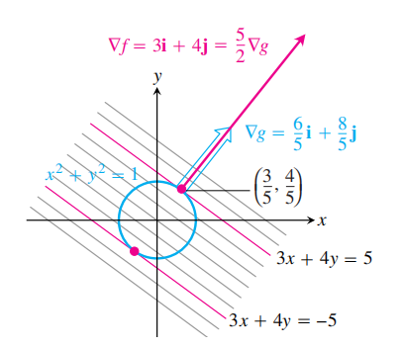
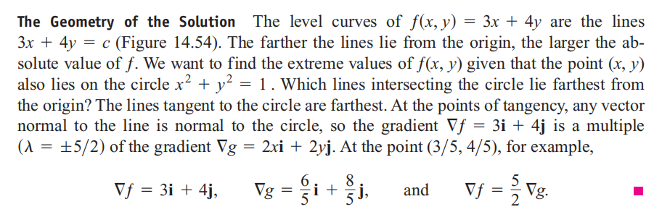

Slide 14
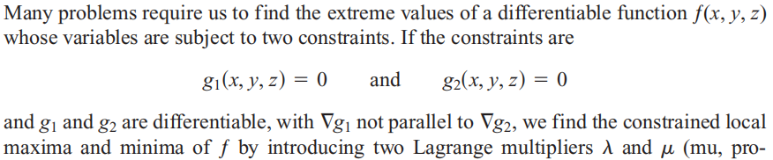
Lagrange Multipliers with Two Constraints
We can construct an aid function, called Lagrange function:
then the suspicious local maximum or local minimum point(s)
will satisfy:

Slide 15
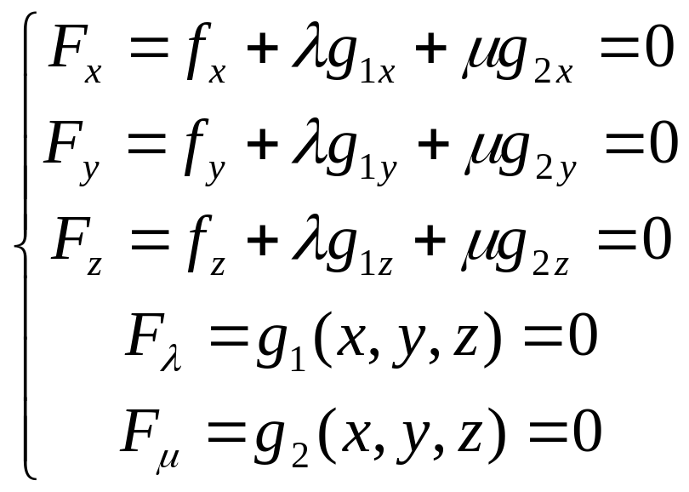
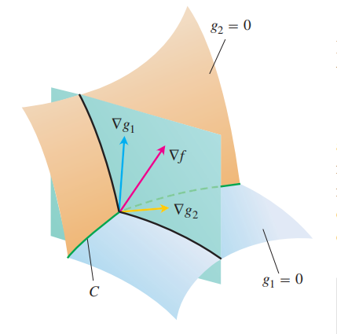

Slide 16
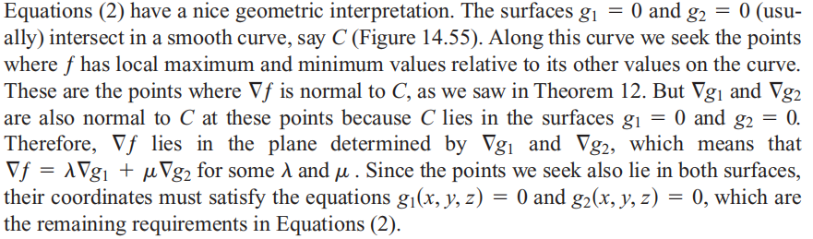

Slide 17
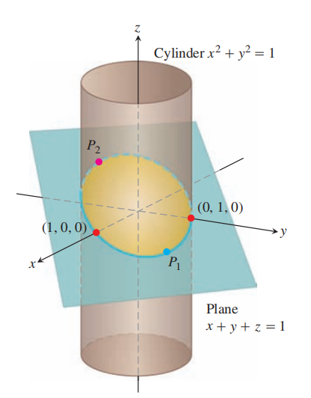

Slide 18



Example：
We want to construct an open-top rectangular box with volume V0 , what is the dimension of the box that will cost least material.

Slide 19
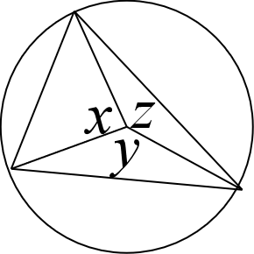
2. Find the largest area of inscribed triangle in the circle with radius R.

